Slide 1
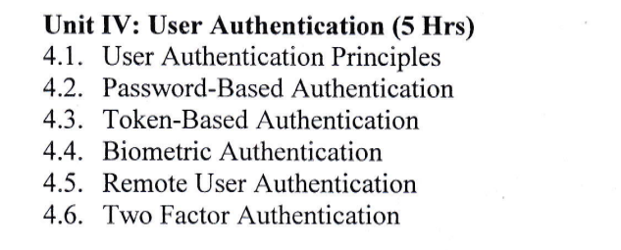

Slide 2
User Authentication
- Authentication is the process of identifying users that request access to a system, network, or device.
- Access control often determines user identity according to credentials like username and password. Other authentication technologies like biometrics and authentication apps are also used to authenticate user identity.

Slide 3
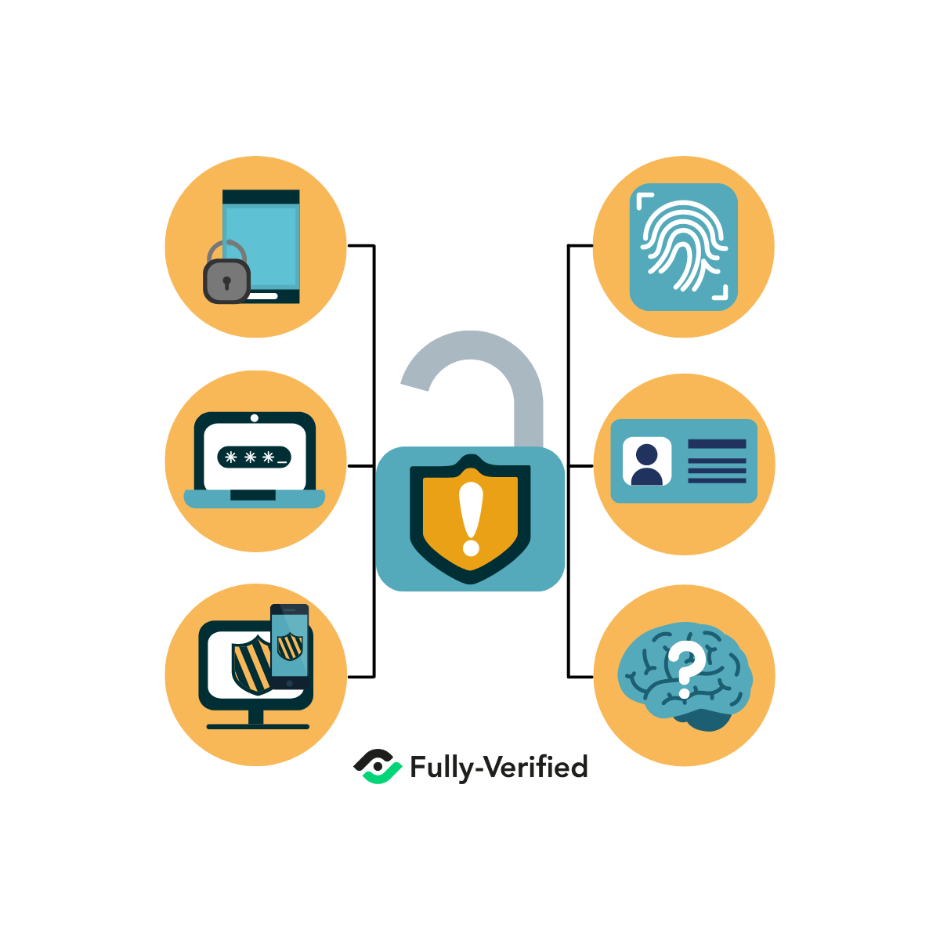
User Authentication

Slide 4
Importance of User Authentication
it is a crucial step in keeping unauthorized users from getting access to sensitive information.
A robust user authentication process is a way to ensure that User A can access only the information he needs and not the sensitive information of User B.
When your user authentication isn’t secure, however, cybercriminals can hack the system and gain access, taking whatever information the user is authorized to access.

Slide 5
4.1 User Authentication Principles
User authentication principles are a set of guidelines and best practices that are used to verify the identity of a user accessing a system, application, or network.
The main principles of user authentication are:
Identification
Authentication
Authorization
Confidentiality
Integrity
Availability

Slide 6
4.1 User Authentication Principles
Identification : user provides a unique identifier, such as a username or email address, to the system.
Authentication : user verifies their identity to the system through a password, passphrase, biometric factor (such as fingerprint or facial recognition), or other means.
Authorization : The system grants or denies the user access to specific resources or actions based on their authenticated identity and the permissions associated with that identity.
Confidentiality : The system ensures that the user's authentication credentials, such as passwords or biometric data, are kept private and not accessible to unauthorized parties.
Integrity : The system ensures that the user's authentication credentials are not tampered with or altered during transmission or storage.
Availability : The system ensures that the user authentication process is available and accessible to authorized users at all times.

Slide 7
Common Authentication Types
Password-Based Authentication
Multi-Factor Authentication
Certificate-based Authentication
Biometric Authentication
Token Based Authentication

Slide 8
4.2 Password-Based Authentication
Password-based authentication is a common method of user authentication that requires a user to provide a password in order to access a system, application, or network.
The password is a secret combination of characters or words that is known only to the user and the system.
When the user enters their password, the system compares it to the stored password to determine whether it matches. If the passwords match, the user is granted access.

Slide 9
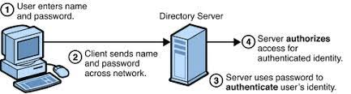
Password Authentication

Slide 10
4.2 Password Based Authentication
To ensure the security of password-based authentication, it is important to follow certain best practices:
Strong Passwords
Password Complexity
Password Policies
Two-Factor Authentication

Slide 11
What is an Authentication token ?
A Token is a computer-generated code that acts as a digitally encoded signature of a user. They are used to authenticate the identity of a user to access any website or application network.
A token is classified into two types:
Physical token : A Physical token use a tangible device to store the information of a user. Here, the secret key is a physical device that can be used to prove the user’s identity.
Web token : The authentication via web token is a fully digital process.

Slide 12
4.3 Token-Based Authentication
Token-based authentication technologies enable users to enter their credentials once and receive a unique encrypted string of random characters in exchange.
You can then use the token to access protected systems instead of entering your credentials all over again.
The digital token proves that you already have access permission.

Slide 13
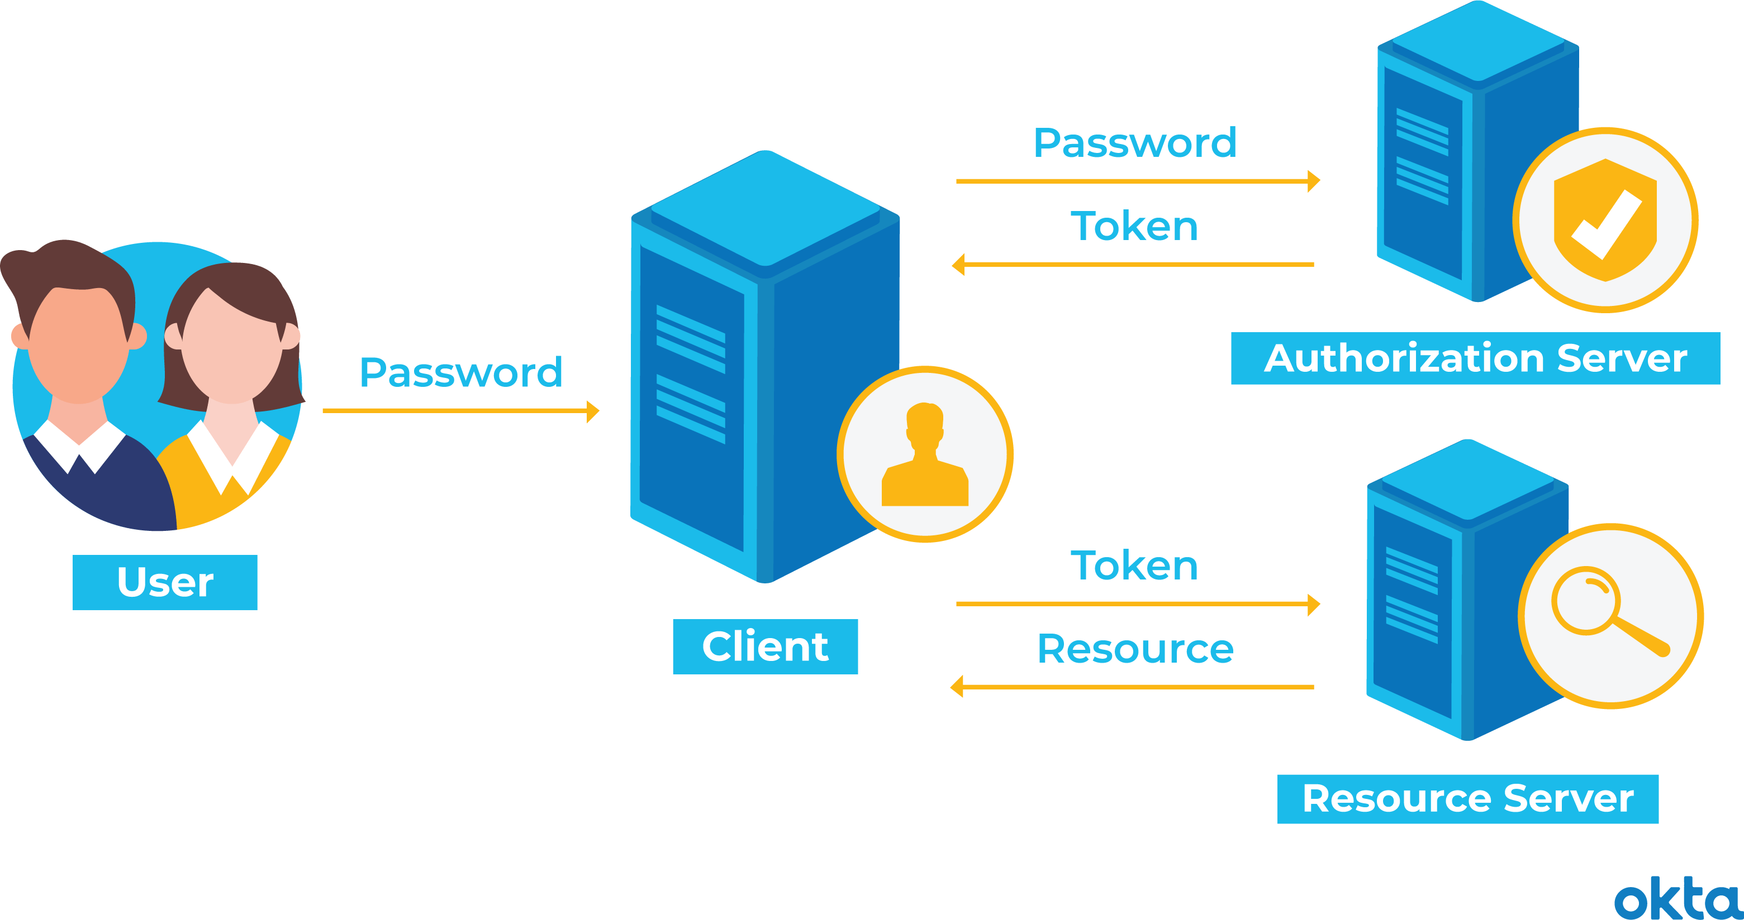
4.3 Token-Based Authentication
Token-based authentication is a protocol that generates encrypted security tokens. It enables users to verify their identity to websites, which then generates a unique encrypted authentication token.

Slide 14
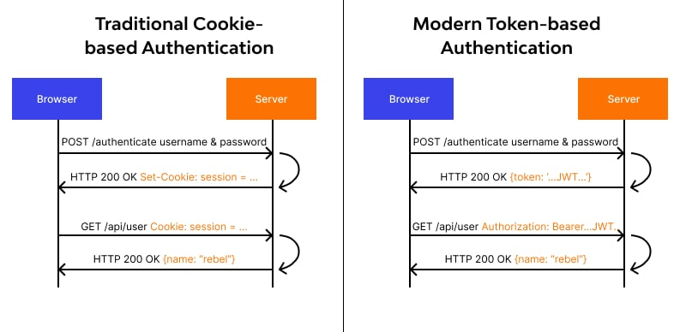

Slide 15
Types of Tokens
Hardware Tokens (USB) : Equipment tokens are actual gadgets that, once approved, permit clients to get to safeguarded networks. They're otherwise called validation or security tokens.
JWPT – JSON Web Tokens: JSON Web Tokens (JWTs) are a secure, compact way to transmit data between parties as JSON objects, often used for authentication and carrying user or account information. They can be included in URLs, POST parameters, or HTTP headers, allowing easy verification without server contact.
OTP Tokens : One time secret key
API Tokens : Oauth2

Slide 16
How does Token-based Authentication work?
This mechanism works with 4 steps:
Request : user intends to enter the service with login credentials on the application or the website interface. The credentials involve a username, password, smartcard, or biometrics
Verification : login information from the client-server is sent to the authentication server for verification of valid users trying to enter the restricted resource. If the credentials pass the verification the server generates a secret digital key to the user via HTTP in the form of a code. The token is sent in a JWT open standard format which includes- header, payload, signature
Token Validation : The user receives the token code and enters it into the resource server to grant access to the network.
Storage : Once the resource server validated the token and grants access to the user, it stores the token in a database for the session time you define.

Slide 17
4.4 Biometric Authentication
refers to a cybersecurity process that verifies a user’s identity using their unique biological traits such as fingerprints, voices, retinas, and facial features.
Biometric authentication systems store this information in order to verify a user’s identity when that user accesses their account.
This type of authentication is usually more secure than traditional forms of multi-factor authentication.

Slide 18
Types of Biometric Authentication methods
Facial Recognition
Fingerprint Recognition
Eye Recognition
Speech Recognition

Slide 19
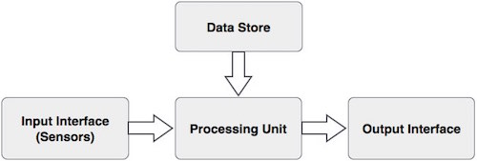
How does Biometric Authentication work? Divided into four components

Slide 20
General working of Biometric System
1. Acquire live sample from candidate. (using sensors)
2. Extract prominent features from sample. (using processing unit)
3. Compare live sample with samples stored in database. (using algorithms)
4. Present the decision. (Accept or reject the candidate.)

Slide 21
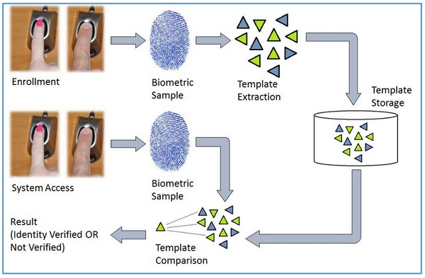
General working of Biometric System

Slide 22
Application areas of Biometric Authentication System
Controlling workplace access.
Identity establishment of people for authentic citizenship and immigration systems.
Applying access control to sensitive information and systems.
Identifying criminals by forensics.
Executing online e-commerce transactions.
Fraud and theft reduction.
Law enforcement.

Slide 23
4.5 Remote User Authentication
the process of verifying users remotely to grant access to the organization's system over a network.
allows your users to log in via outside platforms.

Slide 24
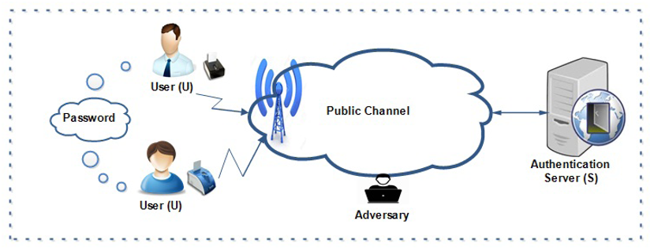

Slide 25
How does Remote User Authentication work?
Identification (Step 1) : The user needs to perform certain identity verification activities, like face authentication, fingerprint scan, voice authentication, password verification, etc
Verification (Step 2): In this step, the information generated is matched with records to ascertain the identity presented in Step 1.

Slide 26
Remote User Authentication
The means of authenticating a user can be:
User knowledge: passwords, answers to specific questions, PIN or OTP.
Organization-issued assets: smart cards, cryptographic keys, physical keys.
Biometric features: face, retina, fingerprints
Biometric characters: Voice recognition, typing rhythm, handwriting

Slide 27
Advantages Drawbacks
Quick Access * Detecting Threats
Cost – Effective * New devices, new threats
Secure * Network dependent
Private
Convenience

Slide 28
4.6 Two Factor Authentication
a type of multi-factor authentication (MFA)
is a security process that cross-verifies users with two different forms of identification, most commonly knowledge of an email address and proof of ownership of a mobile phone.
majorly used on top of the regular username/password verification

Slide 29
Two factor authentication methods:
Knowledge factors (something the user knows) – Common examples are email addresses, username-password combinations, answers to security questions, and the CVV on the back of a credit card.
Possession factors (something the user owns) – Examples of this authentication type include a mobile phone, USB token and a card reader.
Inherence factors (something the user is/has) – This authentication type pertains to unique physical attributes that are inherent to a single person, such as fingerprint readers, retinal scans and voice recognition.

Slide 30
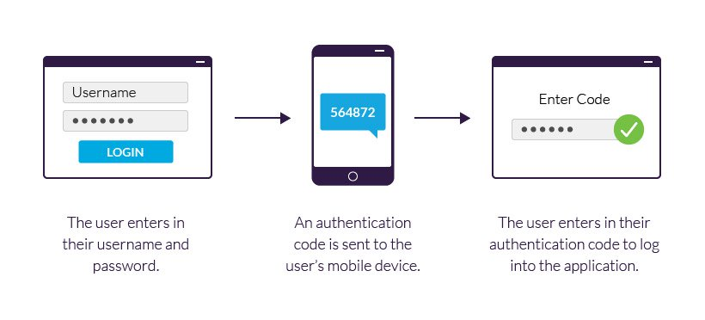
Two factor Authentication

Slide 31
Authentication methods for 2FA
Hardware tokens
SMS verification
Push notifications
Voice-based authentication

Slide 32
2FA vs. MFA
Two-factor authentication helps add a layer of security to all your online personal and business accounts.
Businesses with high-level security (i.e., healthcare facilities, government agencies, or financial services) opt for multi-factor authentication versus two-factor authentication.
2FA utilizes one-time passcodes that are time-sensitive to prevent identity theft. On the other hand, MFA or multi-factor authentication, involves two or more steps or processes to identify a user.

Slide 33
Advantages Drawbacks
Simplicity of usage * Need to pay SMS sending fee
OTP saves you from hacking prone * Can’t be used in absence of cellular coverage
Convenience

Slide 34
Assignment
What are the vulnerabilities of passwords? Explain different strategies used for the selection of effective passwords.
Biometric Authentication is more secure than multi factor authentication. Explain your thoughts.
How can two factor authentication be executed? Explain with examples.
Write short notes on:
Token Based Authentication
Remote User Authentication

